Slide 1
Notes:
My name is ____________. I am part of the HOPUS project and I thank you for this opportunity to share HOPUS with you.

Slide 2
H
O
utreach
P
U
S
ispanic
roject
in the
nited
tates
Notes:
HOPUS is an acronym for Hispanic Outreach Project in the United States.

Slide 3
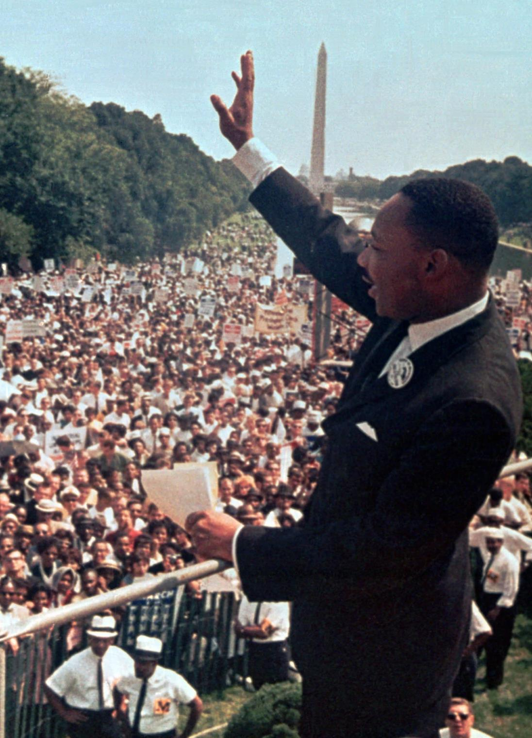
MARTIN LUTHER KING JR.
MARCH 1963
Notes:
In March of 1963, Martin Luther King gave his famous “I have a dream” speech. It inspired millions.

Slide 4
Reaching 100’s of 1000’s of Hispanics in the United States with the full gospel of Jesus Christ
Led to share the gospel
Notes:
HOPUS also has a big dream. Under God, in the next decade, our dream is to reach hundreds of thousands of Hispanics in the United States with the full gospel of Jesus Christ, and to enable hundreds of our congregations to also have a Spanish-speaking ministry, led by men trained through Academia Cristo, with no cost to the congregation or additional time demands on their current ministry.

Slide 5
WE NEED YOUR
PRAYERS
AND
PARTNERSHIP
Notes:
That dream is already becoming reality. But for the dream to come to full fruition, we seek your prayers and your participation.

Slide 6
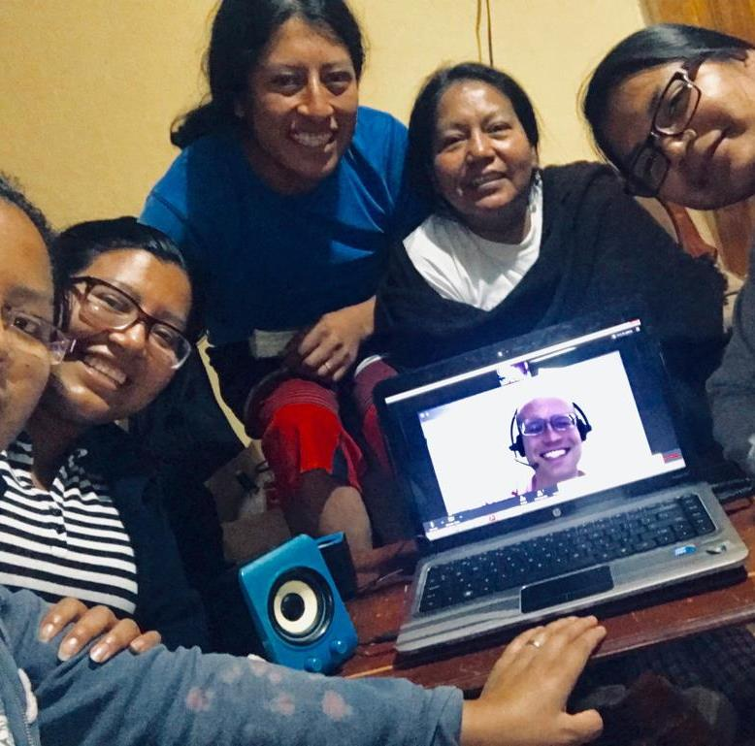
LET'S TALK A BIT ABOUT:
Academia Cristo
HOPUS update
How you can help
Notes:
In this short presentation, let us talk about three things: Academia Cristo, what HOPUS has done to date, and how you can help.

Slide 7
Notes:
Academia Cristo is the program currently used in Latin America to a) thoroughly educate men and women in the Word of God, and b) to prepare them to form group ministries (Grupos Sembrador).
As these groups grow through the Word, both spiritually and numerically, they are recognized as an Iglesia Cristo (Christ Church) belonging to our new Latin American synod, Iglesia Cristo WELS Internacional.

Slide 8
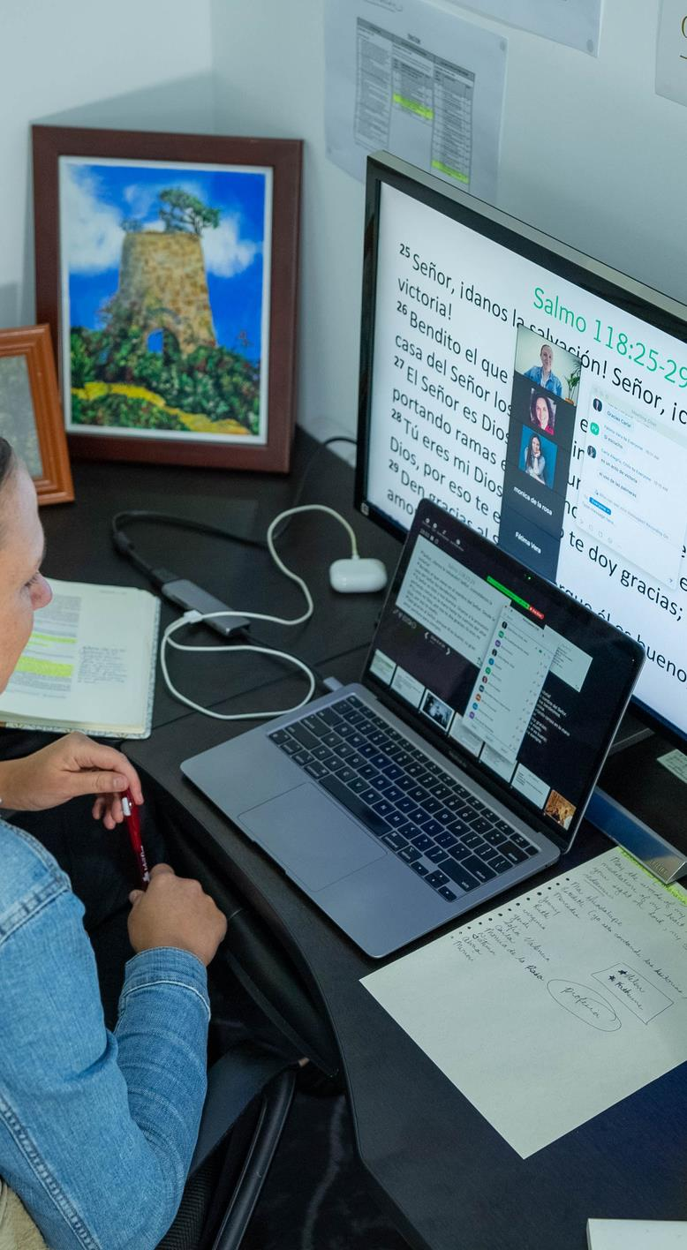
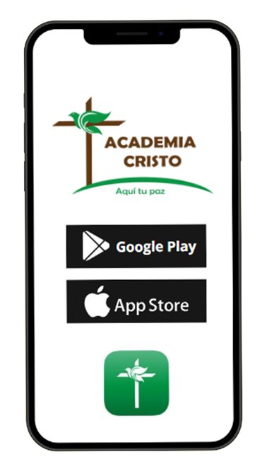
Notes:
The education of these Latino leaders takes place on three levels. It starts when people download the Academia Cristo app and take what is essentially, a self-directed Bible Information Course.
Those that finish the first levels qualify for the next two levels taught via Zoom by our 1LA missionaries and national pastors. Those that complete all three levels have studied with us for approximately two years. It is a thorough process.

Slide 9
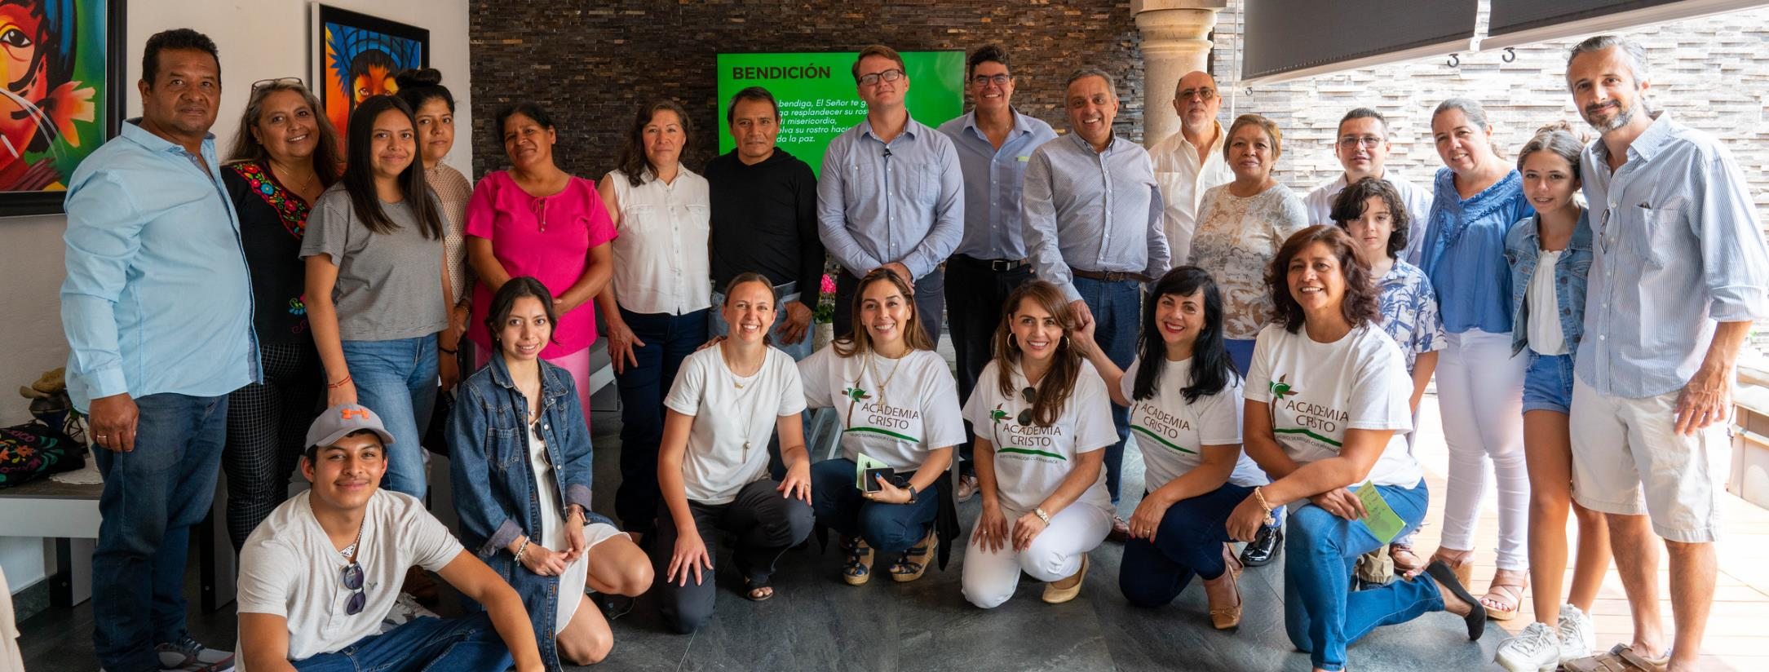
Leadership training
Notes:
Incorporated into these three levels of education in the Word is leadership training that provides them the strategies and materials they will use to form their groups, something they are expected to do during their second and third level of training.

Slide 10
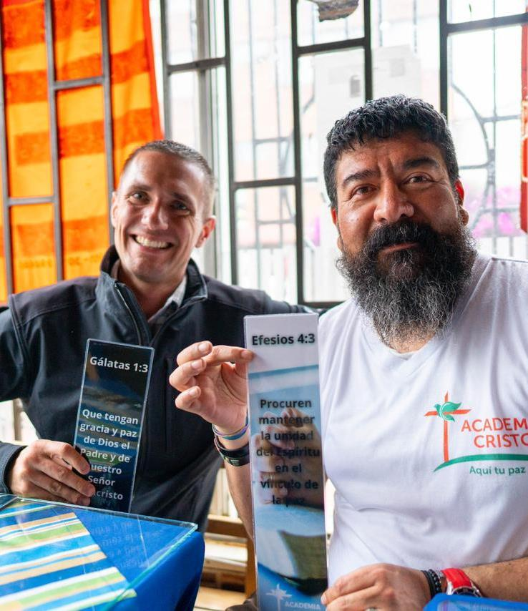
Hundreds of thousands of downloads
Thousands finished
600+ current students
100+ graduated
20 leaders with small groups
Notes:
Although the Academia Cristo program is very young, already hundreds of thousands have downloaded the app. Thousands have finished the first level of self-directed classes. Currently, more than 600 students are in their second level of study and already close to 100 have graduated with many more in the pipeline. At this time, we have 20 leaders who are growing their groups – a number that will grow as more people complete their studies.
Let's take a look at a few examples:

Slide 11
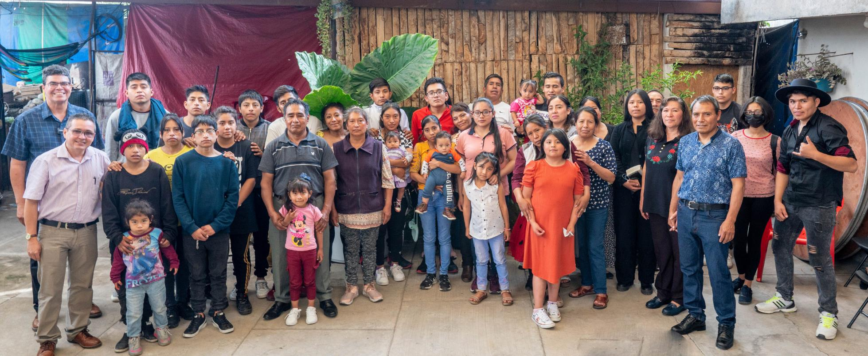
JUAN REYES
Tenancinango, Mexico
Notes:
This is a Grupo Sembrador led by Juan Reyes. He is what we would call a handy man. He didn’t go to university, but he has an intuitive knowledge of how to fix things. He runs his own business. Several months ago, he downloaded the Academia Cristo app and began studying. After finishing the four self-directed courses of the first level, he continued and finished the 13 courses of the second level, Discipleship 1, taught by the 1LA missionaries via Zoom.
The final assignment for which they are trained is to start their own Group. Juan Reyes did that. It has now grown to over 50 people. Not too long ago, after instructing them through our membership class known as Aprendan de Mi (Learn of Me), 18 people were confirmed and celebrated Holy Communion as members of our fellowship.
Juan Reyes lives in Tenancinango, Mexico. This is a city that has the unenviable reputation of being the sex-trafficking capital of the world. By God's grace, and Academia Cristo supported by your mission dollars, Juan Reyes has brought the light of the gospel to this very dark place.

Slide 12
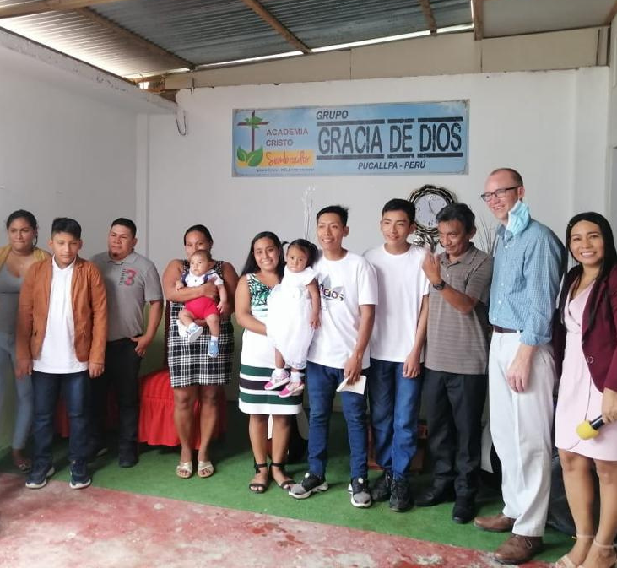
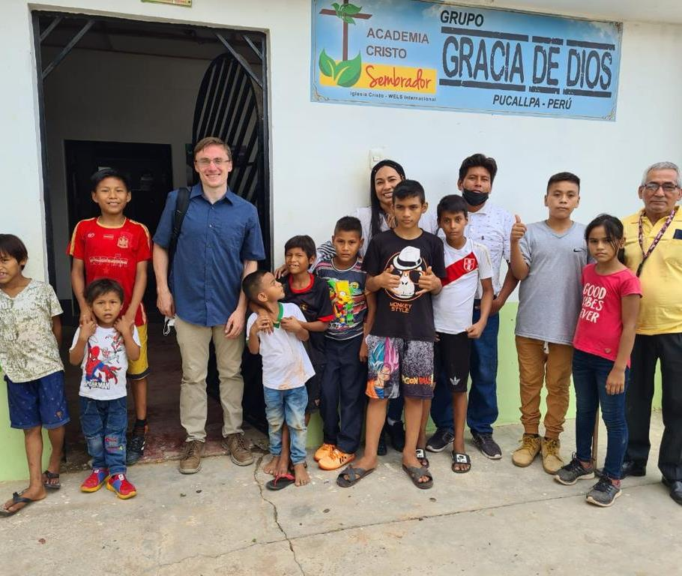
AMELIA TORRES
Pucallpa, Perú
Notes:
This is Amelia Torres. Amelia is approximately 40 years old. She has a doctorate in Anthropology. She lives in Pucallpa (Pu-kai-pa), a gateway river town to the Amazon. She is studying in the third level of instruction, Discipleship 2. She has gathered a group of some 40 people.
Recently, they brought property where, one day, they plan to have their church. This spirit-filled woman has successfully encouraged 4 men in her group to study (they are all in Discipleship 1) with the goal that these men will be the future leaders of the group.

Slide 13
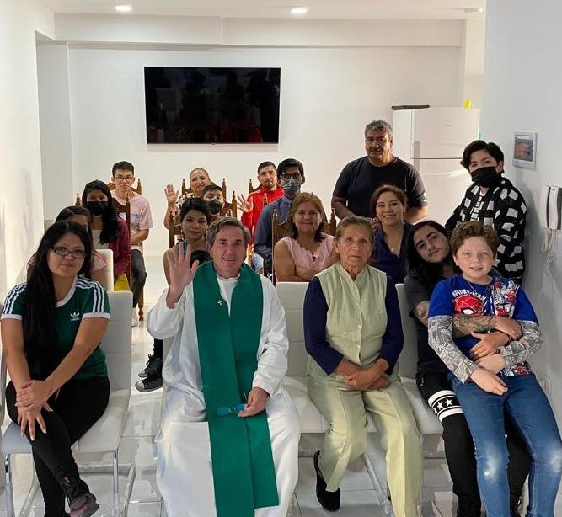
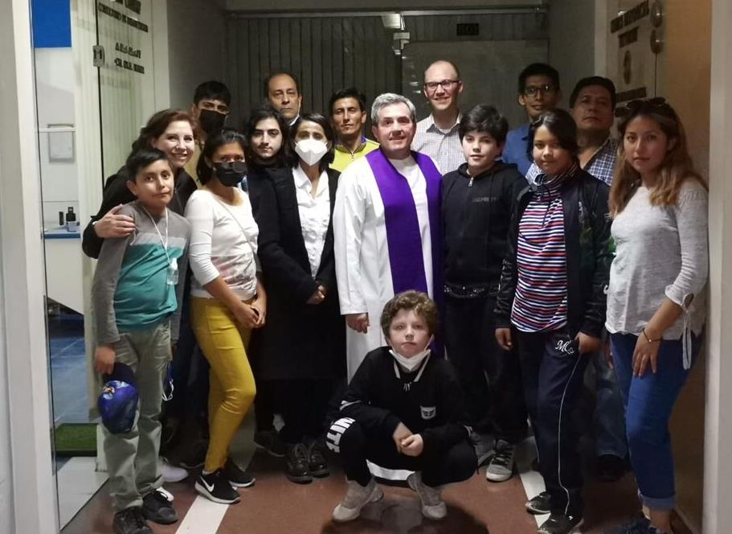
DR. EDUARDO MILENESI
La Paz, Bolivia
Notes:
Finally, we meet Dr. Eduardo Milenesi who lives near La Paz, Bolivia. Dr. Milenesi is an eyes, ears, and throat surgeon. He has a successful practice and is building his own hospital. He was so impressed with what he learned via Academia Cristo, he decided to include a chapel in his building where his Group could meet. These are but three examples of the harvest the Lord is giving us through the teaching of his word.

Slide 14
Academia Cristo is coming to the 60 million Hispanics in the United States
Notes:
The Lord has blessed the work of Academia Cristo in Latin America, and now, with certain modifications, we are applying the same strategy and materials to the 60 million Hispanics in the United States.

Slide 15
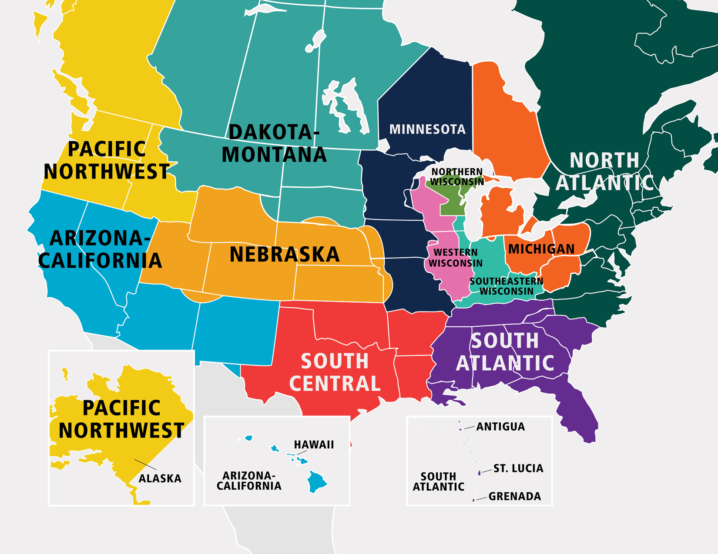
181 congregations with known Hispanics
Ask known Hispanics to reach out to unknown Hispanics
Notes:
It begs the question, “Where to start?” The answer is both simple and obvious. According to our annual statistical report, there are 181 congregations, spread throughout our synod, that have Hispanic members. We call these the “known Hispanics.” We are going to ask them to download the AC app and enroll in the first level of self-directed classes (App classes). While they are studying, we will encourage them to ask the Hispanics in their FRAN network (Hispanics not yet known to us) to do the same. In short, we go from the knowns to the unknowns.

Slide 16
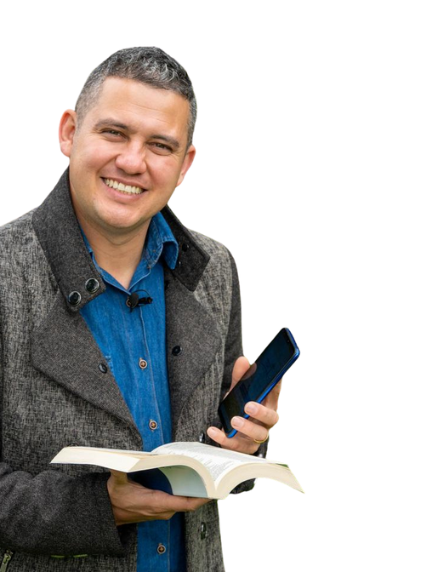
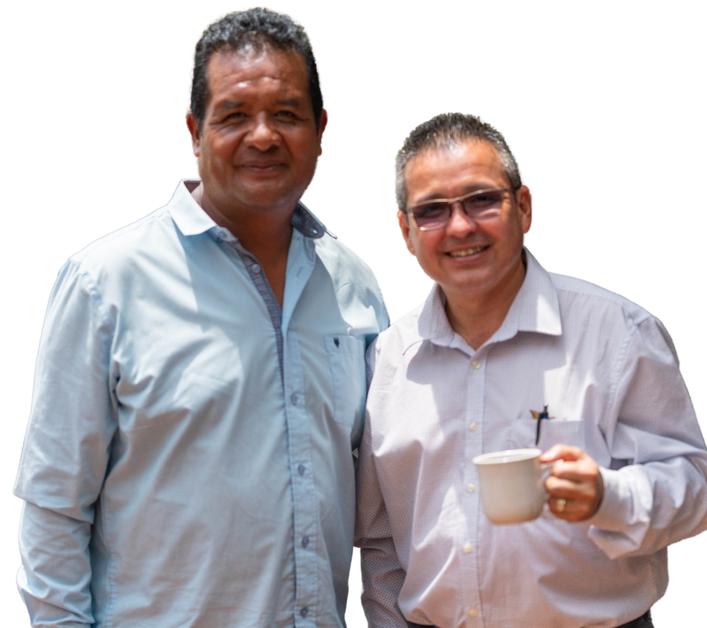
Notes:
We trust in the Lord that some of those who finish the first level will continue to learn and train in the second and third level. These will be our leaders, trained to establish a Spanish-speaking ministry.

Slide 17
You, your church, and
Notes:
To help us reach these 181 congregations, there are 22 pastors, 1 lay minister, and 2 graduates of Academia Cristo who have been trained to implement HOPUS. They are our lieutenants.
Collectively, they have contacted the congregations in their region of responsibility and encouraged the pastor and his congregation to participate in HOPUS.

Slide 18
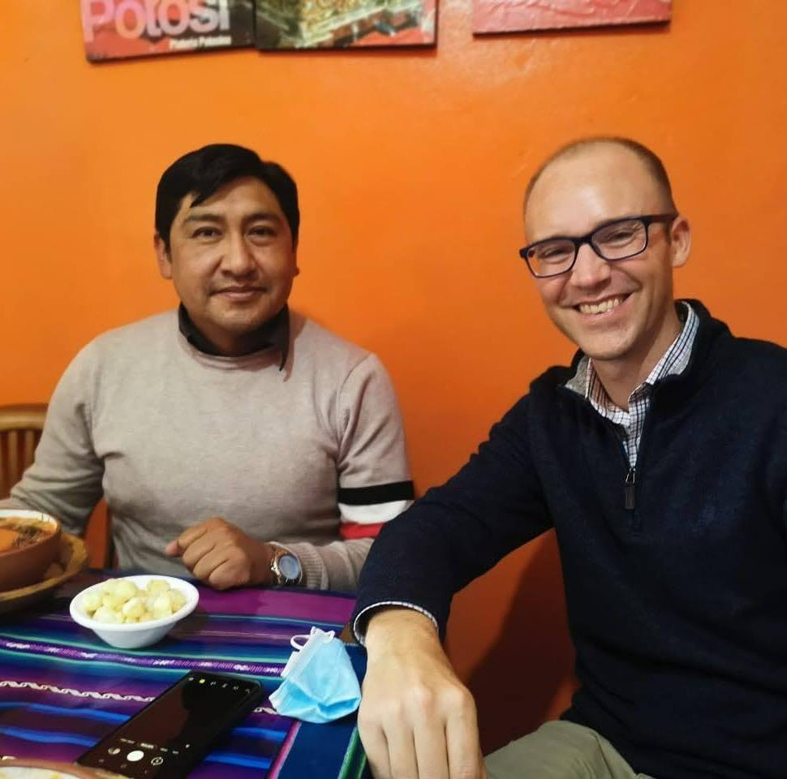
THE PASTOR WILL:
Encourage Hispanics in his church to download the Academia Cristo app and enroll in level 1
Encourage the student to finish
Encourage advanced training
Notes:
Willingness to participate simply means the pastor will encourage his Hispanic members to download the app and enroll in the first level of self-directed courses.
He will be their cheerleader, encouraging them to finish what they have started and to continue to more advanced training as future Hispanic leaders. The rest is in the Spirit’s hands.

Slide 19
WE NEED YOUR
PRAYERS
AND
PARTNERSHIP
Notes:
This is HOPUS in a nutshell. We are grateful for this opportunity to share because we are convinced that there are significantly more congregations with Hispanic members than the 181 mentioned. Perhaps you are one of those congregations, or simply a congregation with Hispanics in your parish area.
Our prayer is that you will also participate in HOPUS. Simply contact your lieutenant and he will give you all the details.
We thank you in advance for your prayers.

